Slide 1
SUPERMARKET SALES ANALYSIS
FEVEN LEGESSE
JEDSON SHANGI

Slide 2
Overview
The growth of supermarkets in most populated cities and market competitions are increasing .
The dataset is one of the historical sales of supermarket company which was recorded in 3 different branches for 3 months (January to March.2019).
Problem statement:
The project aims to explore the supermarket company sales data to find out top performing branches and products, sales trend of various products and customer behavior.
In this analysis 18 business questions are answered.

Slide 3
Data acquisition
Dataset acquired from Kaggle online platform.
Challenges: There were no problems to get the data. But, acquiring data as a supplement from different sources was not possible. Because we couldn't find that could complement with the dataset.
Another obstacle: During the processes of importing the data to MySQL database, we had multiple bugs to fix.
Workflow:Load the data to jupyter notebook from kaggle → Clean the data → Move it to MySQL database → Analyze/extract insight → Back it to Jupyter notebook and visualize some of the insights.

Slide 4
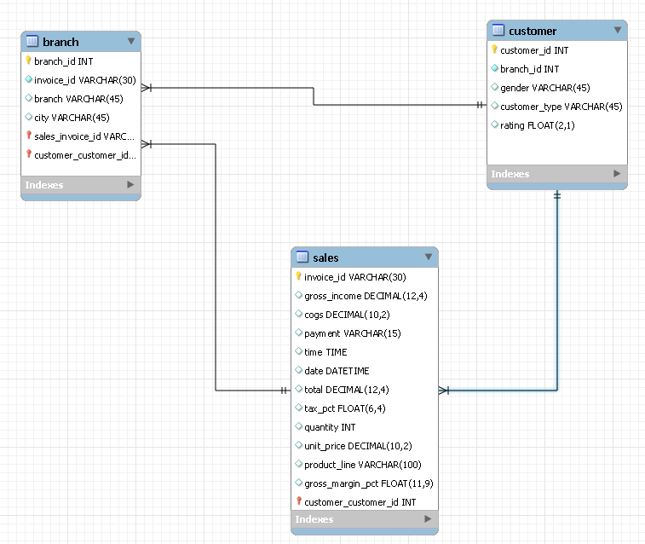
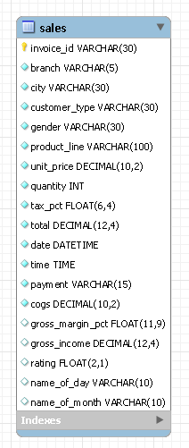
Database Design and Transformation
Transformed to

Slide 5


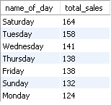
SQL Insights and Analysis
Revenue by Month
Revenue by Customer Type
Sales by Day

Slide 6

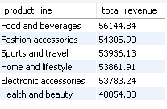
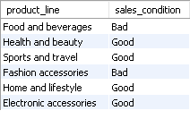
SQL Insights and Analysis
Revenue by Branch & city
Revenue by Product_line
Product_line performance
based on AVG sales
(threshold 5.5 )

Slide 7
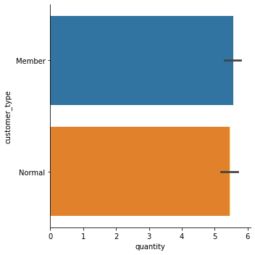

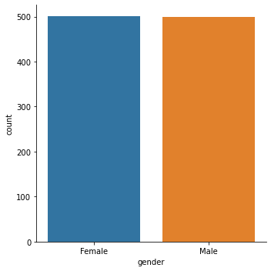

Key Insights
Sales by Customer Type
Customer by Gender

Slide 8
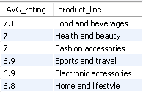
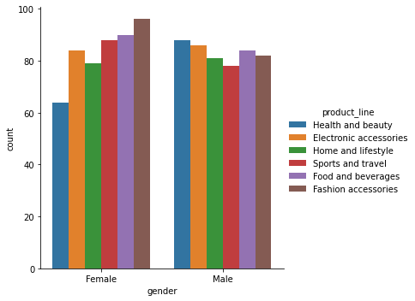
Key Insights
Average Rating by Product Line
Product_line by Gender

Slide 9
Conclusions and Business Implications
Conclusion
Number of male and female customers were almost the same.
Member customers has a slightly high impact on the overall sales and revenue.
Saturday Tuesday and Wednesday were the top 3 purchasing days.
Highest revenue was gained in January and branch ‘C’ was on top followed by branch ‘A’ and ‘B’.
The most sold product_line was in the category of ‘Food and Beverages’ despite bad sales condition and also it got the highest rating.
Further Analysis
Consider to collect more data in the aspect of below listed points to get more insight:
Location based
Means of payments
Products variety

Slide 10
Questions …..
Thank You!
Reference
https://www.kaggle.com/datasets/aungpyaeap/supermarket-sales/data
Rferegghhhhh

